Slide 1
CS F372 Operating Systems
01 – Introduction
Chapter: 1
Sections: 1.1, 1.2, 1.4, 1.5, 2.3, 2.10

Slide 2
Outline
Text Book
Course plan
Evaluation Components
Course Objectives
What is OS? and OS goals
Components of computer system
OS – what it can do?
Computer systems, OS and Interrupts

Slide 3
Text Book
Silberschatz, A, Galvin P.B. and Gange G “Operating System Concepts” 9th edition, Wiley.

Slide 4
Course plan
Lecture Number | Topic(s) | Section(s) of the Text Book
1 | Introduction to OS | 1.1 to 1.3
2, 3 | OS architecture and its components | 1.4 to 1.10
4 | Special purpose systems | 1.11 to 1.12
5-6 | Operating system structures | Ch 2
7-9 | Process Concept, scheduling, operations on processes, Interprocess communication | Ch 3
10-14 | CPU scheduling algorithms | Ch 6
15-16 | Process Synchronization, Critical section problem, Peterson’s solution | 5.1 to 5.3
17-19 | Semaphores, Monitors, Synchronization Hardware | 5.4 to 5.8
20-21 | Deadlock concept, Characterization and methods of handling | 7.1 to 7.3
22-24 | Deadlock detection, Prevention, Avoidance | 7.4 to 7.6
25 | Recovery from deadlocks | 7.7
26-27 | Memory management, Swapping, Allocation | 8.1 to 8.3
28-30 | Concept of segmentation | 8.4, 8.7(Class notes)
31-33 | Concept of Paging | 8.5 to 8.6
34 | Virtual Memory management, Demand paging, Copy-on-write | 9.1 to 9.3
35-36 | Page replacement algorithms | 9.4
37 | Frame allocation and Thrashing | 9.5 to 9.6
38-39 | Secondary storage structure & Management | Ch 10
40-42 | File systems | Ch 11 (Class notes)

Slide 5
Course objectives
Understand what an operating system is
Learn how OS evolved
Study the functions of operating systems
Study the concepts underlying the design and implementation of OS

Slide 6
What is an Operating System?
Software
A program that acts as an intermediary between a user of a computer and the computer hardware
Manages and controls computer’s hardware resources for users and applications
Allocates hardware resources to computer programs in a fair and efficient manner
It is a control program that manages the execution of user programs to avoid errors and improper use of computers

Slide 7
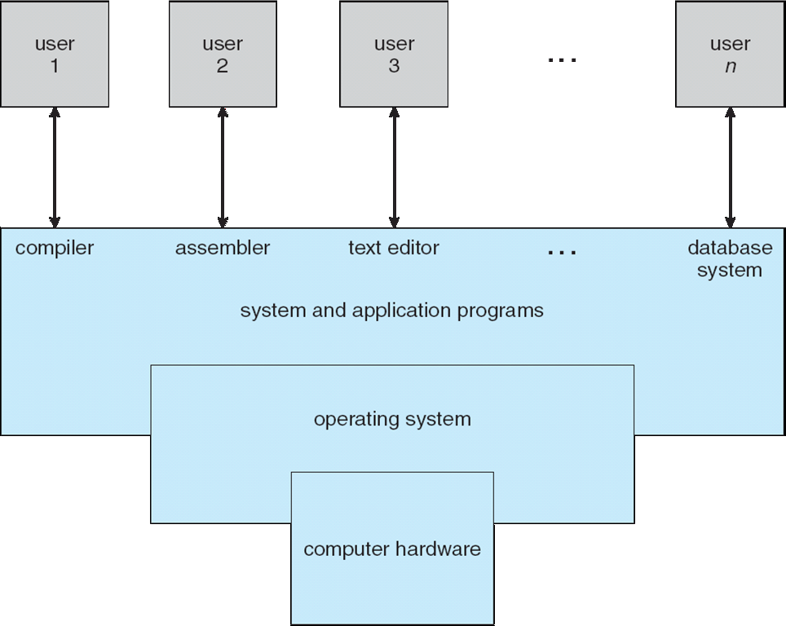
Components of a Computer System

Slide 8
Components of a Computer System
Computer system - four components:
Hardware – provides basic computing resources
CPU, memory, I/O devices
Operating system
Controls and coordinates use of hardware among various applications and users
Application programs – define the ways in which the system resources are used to solve the computing problems of the users
Word processors, compilers, web browsers, database systems, video games
Users
People, machines, other computers

Slide 9

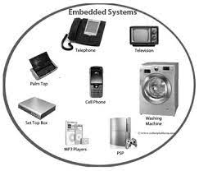

User’s view of OS
User’s view of the computer varies according to the interface being used

Slide 10
User’s view of OS
Personal Computers
Users want convenience - ease of use and good performance
Don’t care about resource utilization
Handheld computers
Resource poor, optimized for usability and battery life
Hence OS for these systems must take these issues into consideration
Embedded computers
Have little or no user interface (such as in devices and automobiles and home appliances)
May have numeric keypads and indicator lights (on/off) to show status
Runs specific programs

Slide 11
Operating system definitions
Resource allocator – manages and allocates resources
Control program – controls the execution of user programs and operations of I/O devices
“The one program running at all times on the computer” is the kernel

Slide 12
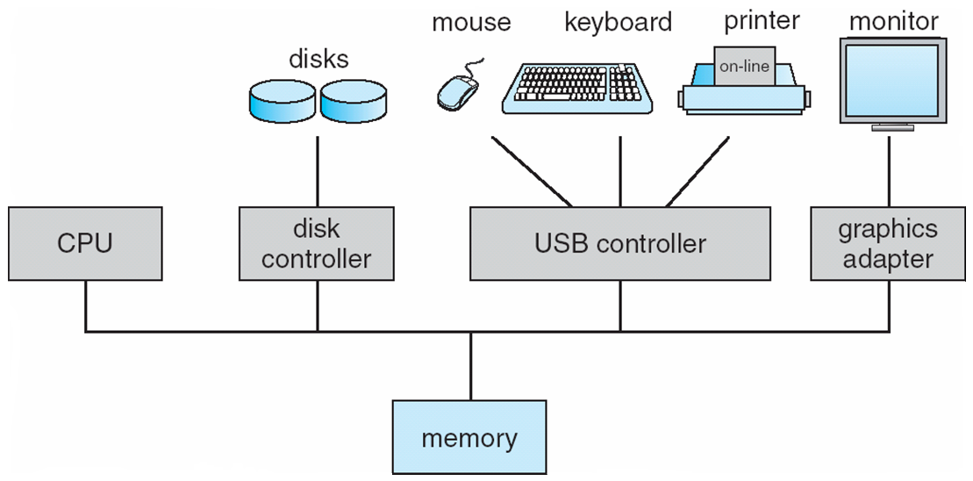
Computer System Organization
General purpose computer-system
One or more CPUs, device controllers connect through common bus providing access to shared memory

Slide 13
Computer System Organization
I/O device controllers and the CPU can execute concurrently
Each device controller is in charge of a particular device type
Each device controller has a local buffer
Data is moved between the peripheral devices and local buffers by the device controller
Device controller informs CPU that it has finished its operation by causing an interrupt

Slide 14
Computer System Organization
Device driver:
Operating systems have a device driver for each device controller
This device driver understands the device controller and provides the operating system with a uniform interface to the device.

Slide 15
Computer Startup/System Boot
Booting:
Loading of the OS into the primary memory
When does booting occurs ?
When system is powered-on or rebooted
Who loads the kernel on booting?
Bootstrap loader or bootstrap program
Where is the bootstrap program kept?
Typically stored in ROM or EEPROM
Generally known as firmware

Slide 16
Computer Startup/System Boot
What happens on power-on?
The PC is loaded with a predefined memory location
Execution starts at that fixed memory location
At that location is the initial bootstrap program
Bootstrap loader: Tasks
Run diagnostics to determine the state of the other hardware attached to the machine (POST – Power on self test)
Initializes all aspects of system (CPU registers, device controllers and the contents of main memory)
Loads operating system kernel

Slide 17
Computer Startup/System Boot
IA–32 (Intel Architecture, 32-bit)
BIOS (Basic Input/Output System) which comprises the bootloader
Unified Extensible Firmware Interface, or UEFI successor of BIOS for 64-bit architecture
Linux & UNIX systems
GRUB, or GRand Unified Bootloader (open source bootstrap program)
Mobile systems - Android
vendors provide boot loaders
most common Android boot loader is LK (for “little kernel”)

Slide 18
Computer Startup/System Boot
Some services are provided outside of the kernel by system programs that are loaded into memory at boot time to become system daemons, which run the entire time the kernel is running.
On Linux, the first system program is “systemd,” and it starts many other daemons.
Once this phase is complete, the system is fully booted, and the system waits for some event to occur.

Slide 19
Interrupts
Consider a program performing I/O.
To start an I/O operation, the device driver loads the appropriate registers in the device controller.
The device controller, in turn, examines the contents of these registers to determine what action to take (such as “read a character from the keyboard”).
The controller starts the transfer of data from the device to its local buffer.
Once the transfer of data is complete, the device controller informs the device driver that it has finished its operation.

Slide 20
Interrupts
The device driver then gives control to other parts of the operating system, possibly returning the data or a pointer to the data if the operation was a read.
For other operations, the device driver returns status information such as “write completed successfully” or “device busy”.
How does the controller inform the device driver that it has finished its operation?
This is accomplished via an interrupt.

Slide 21
Interrupts
Modern day OS are event driven
What is interrupt?
It is an asynchronous request to the CPU
It can be initiated anytime without reference to the system clock
What causes an interrupt?
Hardware or software
Why is interrupt caused?
Occurrence of an event

Slide 22
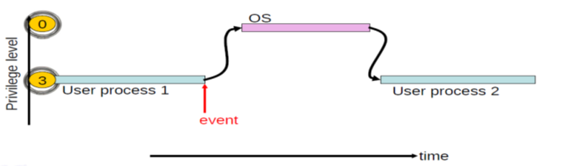
Interrupts

Slide 23
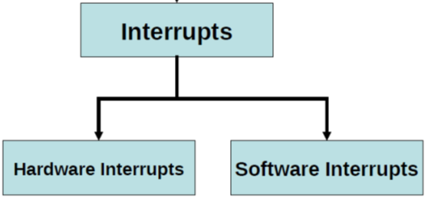
Interrupt types
Hardware Interrupt is caused by hardware device
Avoid wasting the processor’s valuable time in polling loops
Software Interrupt is caused by an instruction in a program

Slide 24
Interrupt handling
How does a device interrupts the CPU?
The device issues an interrupt signal to the processor on the interrupt request line
When does the processor responds to an interrupt?
The processor completes the execution of the current instruction (finishes the current instruction cycle) and then responds to the interrupt
How does the CPU responds back?
Its sends an acknowledgement signal back to the device
Hence the device removes the interrupt signal

Slide 25
Interrupt handling
What happens when interrupt occurs?
CPU finishes the execution of the current instruction and checks for interrupts
Stores contents of Program Counter (return address) and processor state onto stack
Services the interrupt
Transfer control to interrupt service routine (ISR) and execute it
After the interrupt is serviced
Restore the processor state
Load the saved return address into the program counter
Resume the interrupted computation

Slide 26
Interrupt handling
What is an ISR or interrupt handler?
It is a program that services the interrupting source

Slide 27
OS should guarantee that the interrupt latency is less than a
specified value

Slide 28
Interrupt Vector Table
Where are the ISRs placed?
Placed in a fixed location in memory
How is the mapping between the interrupt source and ISR done?
Interrupt vector table (IVT)
Vectored interrupts
Interrupt vector table (IVT)
Acts as a pointer to the ISRs
Table contains the addresses of the ISRs

Slide 29
Interrupt Vector Table
What is an interrupt vector
An interrupt request specifies a code/type of the interrupt
It is used as an index/pointer into the IVT to identify the address of the ISR

Slide 30
Case Study: 8086 interrupt handling
Generally
(ISR address location in IVT)H = (Interrupt vector)H * (No. of locations for one entry in the vector table)H + starting address of IVT
At the end of each instruction cycle 8086 processor checks to see if there is any interrupt request. If so, 8086 responds to the interrupt by performing series of actions
It pushes the flag register on the stack
It pushes the current code segment (CS) register contents on the stack
It pushes the current instruction pointer (IP) contents on the stack
It jumps to the start of the ISR by loading the new CS and IP values for the start of the interrupt service routine (ISR)
An IRET instruction at the end of the interrupt service procedure returns execution to the interrupted program

Slide 31
Case Study: 8086 interrupt handling
“How to get the values of CS and IP register ?”
The Interrupt Vector Table in 8086
Occupies the address range from 00000H to 003FFH (the first 1024 bytes in the memory map)
Each entry in the Interrupt Vector Table is 4 bytes long:
The first two bytes represent the offset address (IP)
The last two bytes represent the segment address of the ISR (CS)
The 8086 gets the new values of CS and IP register from four memory addresses (locations)
8086 supports 256 interrupts

Slide 32
Case Study: 8086 interrupt handling
Using the Interrupt Vector Table (of an 8086 processor operating in real mode) shown below, determine the address of the ISR of a device with interrupt vector 42H.

Slide 33
Case Study: 8086 interrupt handling
Answer:
Address in table = 4 X 42H = 108H = 00108H
(Multiply by 4 since each entry is 4 bytes)
Offset (IP) Low = [00108] = 2A
Offset (IP)High = [00109] = 33
Segment (CS) Low = [0010A] = 3C
Segment (CS) High = [0010B] = 4A
Address = 4A3C:332A = 4A3C0 + 332A = 4D6EA H

Slide 34
Hardware (external) interrupts
Generated by hardware
Useful when interfacing I/O devices with low data-transfer rates with the processor
Example: Keyboard, mouse, printer, etc.,
Avoids polling the device which wastes valuable processing time
The peripheral interrupts the normal application execution of the processor, requesting to send or receive data

Slide 35
Storage Definition
The basic unit of computer storage is the bit
A bit can contain one of two values, 0 and 1
Byte is 8 bits
Word
A computer architecture’s native unit of data
made up of one or more bytes
A kilobyte, or KB, is 1,024 bytes
a megabyte, or MB, is 1,024² bytes
a gigabyte, or GB, is 1,024³ bytes
a terabyte, or TB, is 1,024⁴ bytes
a petabyte, or PB, is 1,024⁵ bytes
exabyte, zettabyte, yottabyte

Slide 36
Storage Structure
Main memory – the only large storage media that the CPU can access directly
Random access; volatile; small size
Load and store data
Secondary storage – extension of main memory that provides large nonvolatile storage
Slower than main memory
Tertiary storage –magnetic tapes, CD, DVD
Backup
Very large storage; very slow

Slide 37
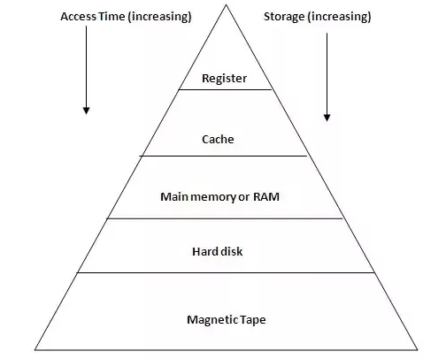
Storage-device hierarchy

Slide 38
Cache memory
Information in use is copied from slower to faster storage temporarily
Faster storage (cache) checked first to determine if information is there
If it is, information used directly from the cache (fast)
If not, data copied to cache and used there
Cache are smaller (size-wise) than storage being cached
Cache management important design problem
Cache size and replacement policy

Slide 39
Performance of Various Levels of Storage

Slide 40
Computer-System Architecture
According to the number of general-purpose processors used
Single-Processor Systems
Multiprocessor Systems
Single-Processor Systems
Used by most computer systems many years ago
1 processor (physical chip) with 1 core (computation unit)

Slide 41
Computer-System Architecture
Multiprocessors systems
Present in: modern computers, mobile devices, servers
Traditionally 2 or more processors each with 1 core
Processors share the computer bus, the clock, memory, and peripheral devices
Advantages include:
Increased throughput
Increased reliability

Slide 42
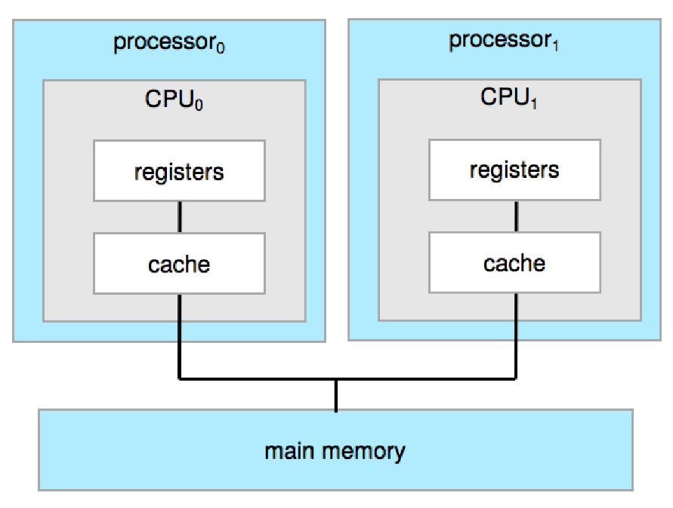
Computer-System Architecture
Two types:
Asymmetric Multiprocessing – each processor is assigned a specific task
Symmetric Multiprocessing – each processor performs all tasks
Traditional
multiprocessing architecture

Slide 43
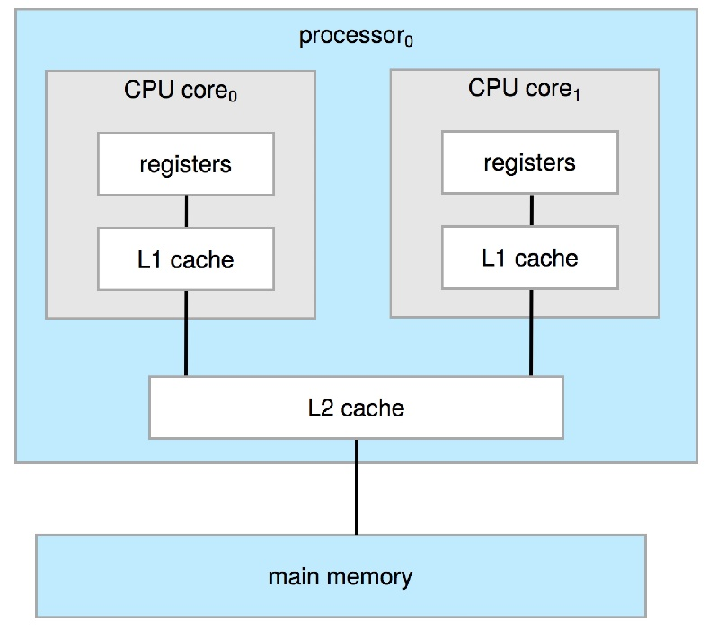
Computer-System Architecture
Modern day multiprocessors are multicore systems
multiple computing cores reside on a single chip
Advantages
on-chip communication is faster than between-chip communication
Lesser power consumption
A dual-core design with two cores on the same chip

Slide 44
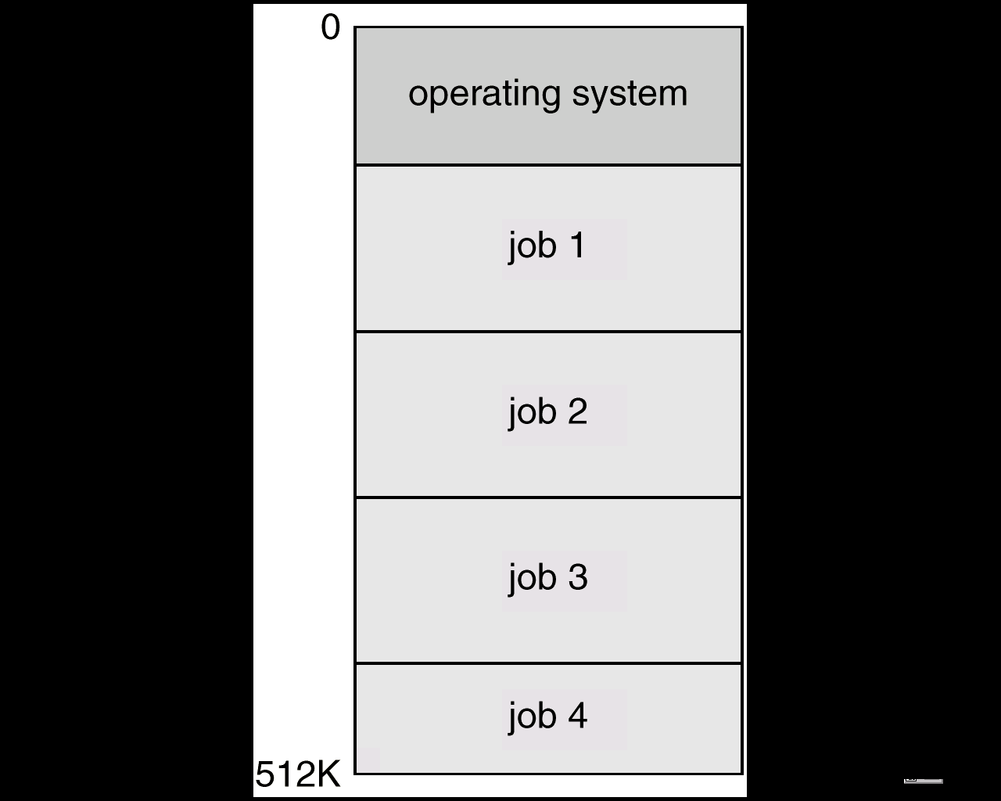
OS Structure: Multiprogramming
Memory Layout for multiprogramming
Several jobs are kept in main memory at the same time
One job is executed at a time
When a job terminates or goes for I/O, OS switches to another job
Another job starts executing
CPU is never idle

Slide 45
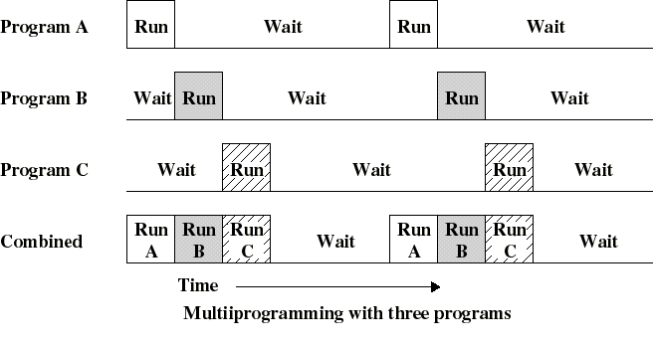
Multiprogramming

Slide 46
Features of OS needed for multiprogramming
Process management – Mange multiple jobs
Jobs entering the system is kept in job pool in disk
Job scheduling
Subset of jobs is placed in main memory
CPU scheduling – the operating system must choose among several jobs ready to run
Process synchronization & Deadlock Management
Memory management – the operating system must allocate the memory to several jobs ensuring memory protection
Storage Management
File System Management, Mass storage Management

Slide 47
Time Sharing Systems (TSS)
Multiprogramming does not support interaction with users
TSS extends multiprogramming to handle multiple interactive jobs
Processor’s time is divided into small slice/quanta and is shared among multiple users
Multiple users simultaneously access the system through terminals
Improves user response time
Gives illusion that each user has his own machine

Slide 48
Time sharing systems – features
Job scheduling, CPU scheduling
Many users program ….. Memory management
Reasonable response time is ensured by
Virtual memory : allow execution of a programs larger than the physical memory
Job is swapped in and out of memory to the disk
File System and Disk Management
Job synchronization and communication - orderly execution
Handling deadlocks – avoid forever waiting of jobs
Protection and security

Slide 49
Software interrupts
Also called as trap or exception
Triggered by software
Causes of software interrupt
Exception: error conditions
Example: Divide by zero, invalid memory address
Specific request from a user program that an operating-system service be performed
Example: Write a value to an output device
Executes a special operation called a system call or monitor call

Slide 50
Dual-Mode Operation
OS and users share the hardware and software resources of the computer system
Ensure that an error in a user program could cause problems only for the one program running
Example
If a process gets stuck in an infinite loop
One erroneous program might modify another program, the data of another program, or even the operating system itself
A properly designed operating system must ensure that an incorrect (or malicious) program cannot cause other programs to execute incorrectly

Slide 51
Dual-Mode Operation
Solution: Dual-mode operation
User mode and kernel mode (supervisor mode, system mode, or privileged mode)
Mode bit is added to the hardware
Provides ability to distinguish when system is running user code or kernel code
Mode bit: kernel (0), user (1)
When the computer system is executing on behalf of a user application, the system is in user mode
When the computer system is executing the OS code, then the system is in kernel mode

Slide 52
Dual-Mode Operation
At system boot time, the hardware starts in kernel mode (mode bit = 0)
The operating system is then loaded and starts user applications in user mode (mode bit changes from 0 to 1)
Whenever a trap or interrupt occurs, the hardware switches from user mode to kernel mode (mode bit changes from 1 to 0)
Thus, whenever the operating system gains control of the computer, it is in kernel mode

Slide 53
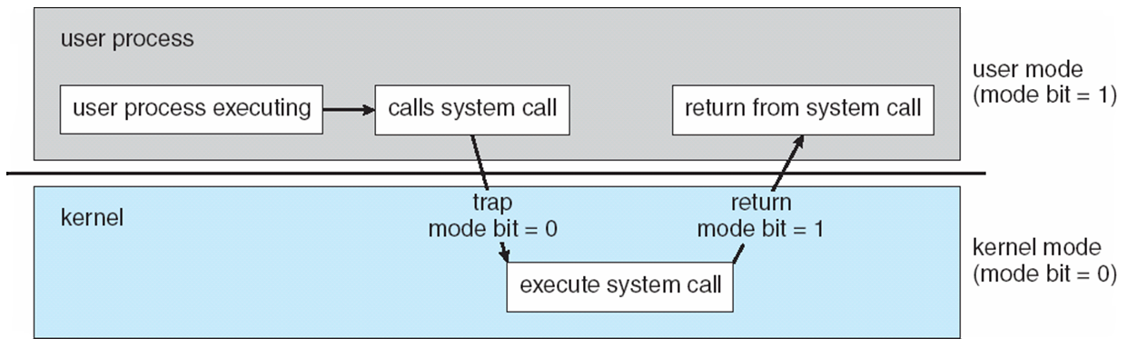
Dual-Mode Operation

Slide 54
Dual-Mode Operation
How dual mode protects OS and other user programs from errant users?
Some instructions that might cause harm are designated as privileged instructions
Hardware allows privileged instructions to be executed in only kernel mode
If an attempt is made to execute a privileged instruction in user mode, the hardware does not execute the instruction but rather treats it as illegal and traps it to the operating system
Example: instruction to switch to kernel mode, I/O control, timer management, and interrupt management

Slide 55
System Calls
Means for a user program to ask the operating system to perform tasks reserved for the operating system on the user program’s behalf
Interface to the services provided by the OS
Written in ALP or in a high-level language (C or C++)

Slide 56
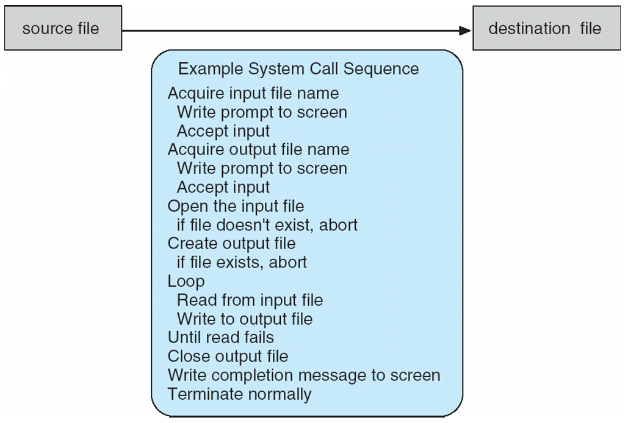
Example of System Calls
System call sequence to copy the contents of one file to another file

Slide 57
System Calls
Application developers (or) users use Application Programming Interface (API) which invokes the actual system calls
The API specifies
a set of functions
parameters that are passed to each function
the return values the programmer can expect
APIs are implemented as libraries
Example libc (standard C language library) is provided for programs in C language
APIs invoke the actual system call

Slide 58
System Call Implementation
The run time support system of programming languages provides a system-call interface
Typically, a number is associated with each system call
System-call interface maintains a table indexed according to these numbers
The table contains the starting address of the implementation of the system call routine
The system call interface
Intercepts the function calls in the API
Invokes the intended system call in OS kernel
Returns status of the system call and any return values
The caller need not know anything about how the system call is implemented
Just needs to obey API and understand what OS will do as a result of the call

Slide 59
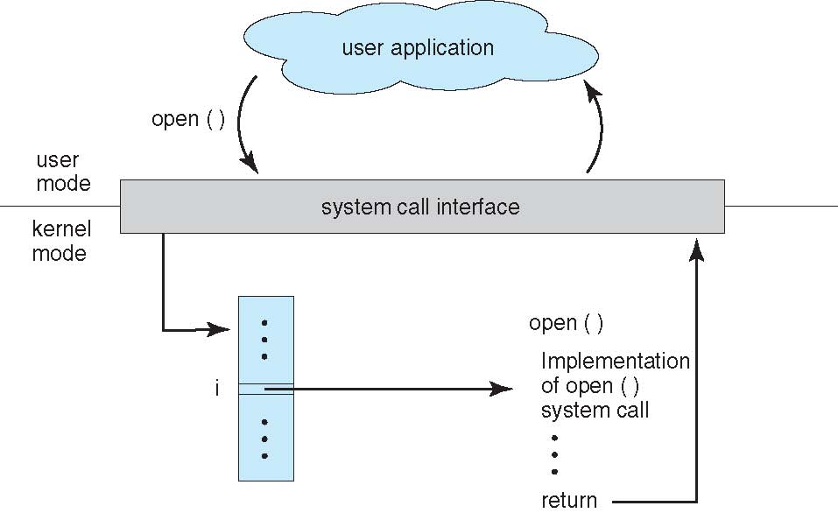
API – System Call – OS Relationship

Slide 60
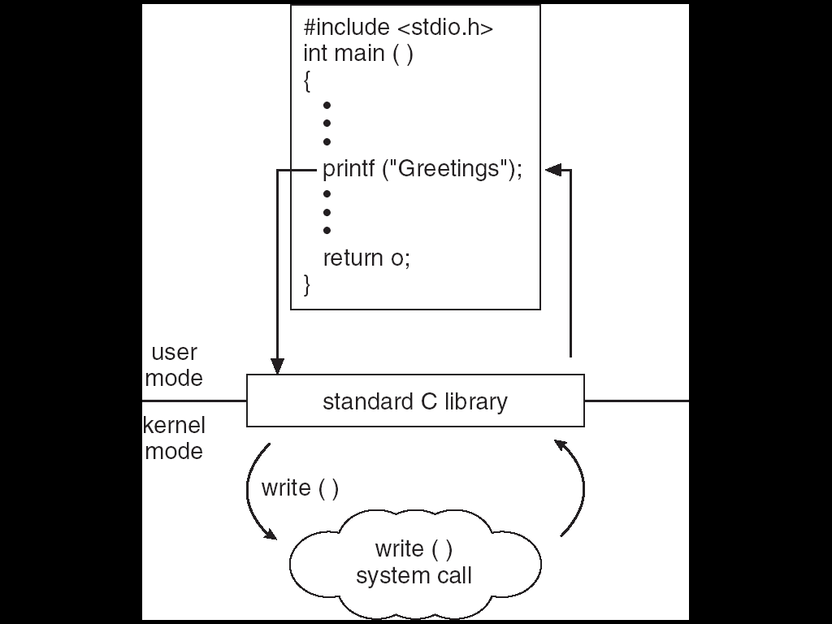
Standard C Library Example

Slide 62
System Call Parameter Passing
Three general methods used to pass parameters to the OS
Simplest: pass the parameters in registers
In some cases, may be more parameters than registers
Parameters stored in a block, or table, in memory, and address of block passed as a parameter in a register
This approach taken by Linux and Solaris
Parameters placed, or pushed, onto the stack by the program and popped off the stack by the operating system

Slide 63
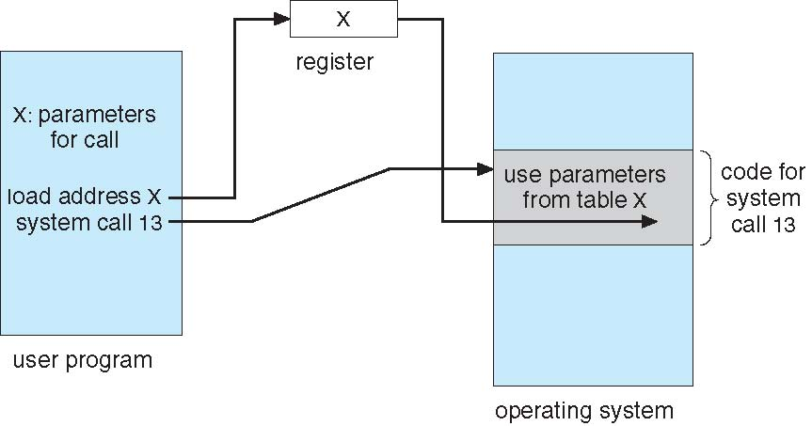
Parameter Passing via Table

Slide 64
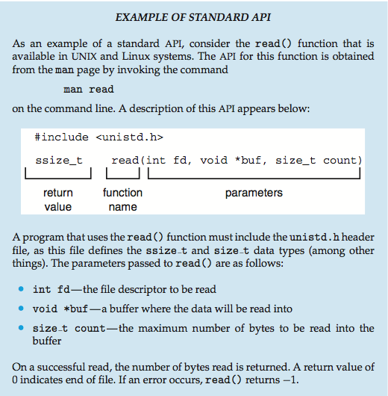
Example of Standard API

Slide 65
System call for file read in C
int main(int argc, char *argv[])
{ int fd;
char content[100]="\0";
fd = open(argv[1], O_RDONLY);
if(fd < 0)
{ printf("File could not be opened.\n");
perror("open");
return; }
else
{ read(fd, content, sizeof(content)-1);
write(1, content, sizeof(content)-1);
}
return;}

